Slide 1
Ten questions to consider in designing an impact evaluation

Slide 2
What is impact?
The difference in outcomes with the program versus without the program – for the same unit of analysis (e.g. individual).
……..but does this not sound very straightforward?
One reasonably straightforward view (Ravaillon, World Bank)

Slide 3
Naïve comparison 1: Before vs after. We observe an outcome indicator,
Intervention

Slide 4
and its value rises after the program:
The difference in outcomes with the program versus without the program – for the same unit of analysis (e.g. individual)
Intervention

Slide 5
However, we need to identify the counterfactual…
Intervention

Slide 6
… since only then can we determine the impact of the intervention

Slide 7
DO WE ALSO NEED TO KNOW WHAT IS IT ABOUT THE PROGRAM THAT CAUSED THE EFFECT?
But is this empirical view of impact evaluation enough? Is this enough of a basis to generalize the results of the evaluation?

Slide 8
Different models of causality
Successionist
“......what is needed to infer causation is the ‘constant conjunction’ of events: when the cause X is switched on (experiment) effect Y follows, and when the cause is absent (control) no effect is observed.”
Generative
“The generative model calls for a more complex and systemic understanding of connectivity. It says that to infer a causal outcome (O) between two events (X and Y) one needs to understand the underlying generative mechanism (M) that connects them and the context (C) in which the relationship occurs.”
(Pawson et al, 2004, p, 2)

Slide 9
A concrete example—further wisdom from Pawson
“To use a physical science example, researchers would not claim that repeated observations of the application of a spark (X) to gunpowder and the subsequent explosions (Y) was a sufficient base on which to understand the causal relationship. Rather the connection (O) is established by what they know about the chemical composition of gunpowder and its instability when heat is applied (M). They also know that this mechanism is not always fired and that the explosion depends on other contextual features (C) such as the presence of oxygen and the absence of dampness.” (Pawson et al., 2004, p. 2)
……notice the question is shifting….it is not simply does a program work? ….but what is it about a program that brought about the change

Slide 10
Developmental Evaluation
Formative
Developmental
Summative

Slide 11
The Questions (1)
1. What is the purpose of the evaluation?
3. Is there clarity on the program theory? Does the program theory help identify the key outcomes?
2. Is your program or policy stable over time?
4. Is there clarity on the anticipated trajectory of impacts (if the program is successful)? Is there clarity on the anticipated earliest timeline of impact?

Slide 12
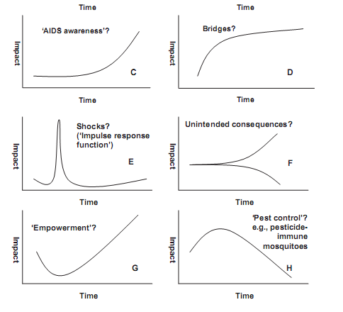

Slide 13
The Questions (2)
5. How will the program’s context be measured? Process? Key outcomes? Are the measures being collected over time?
6. What evaluation design is being implemented to decide if a program was successful? Was the key informed by the theory of change? Did the design pay attention to key linkages in the program theory? Was the design informed by the anticipated impact trajectory?

Slide 14
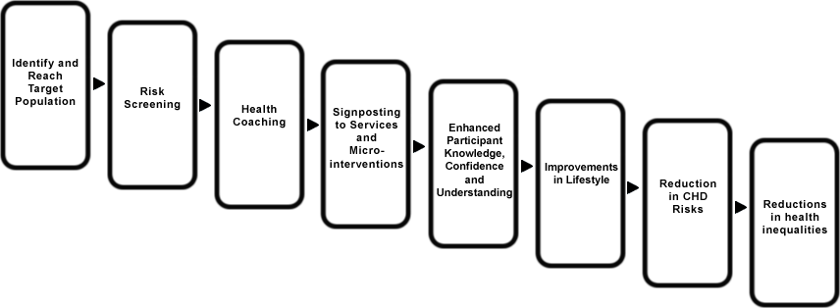
What is the program? One example

Slide 15
The Questions (3)
7. What analytical methods will be implemented to decide if the program was successful? Can qualitative and quantitative methods both be used to decide if the program was successful?
9. What are some of the unintended consequences of the program? What method/approaches are implemented to learn about the unintended consequences?
8. What methods are used to learn about the heterogeneous impacts of the program? Did the program impact have differential impacts on different populations?
10. What has been learned about how the program impacts intended beneficiaries? How should the program be modified to impact intended beneficaries?

